Slide 1
INTRODUCTION TO COMPUTING
Course Code: CCINCOM/L
Data Collection: Practices, Bias, Risks
Elizer Ponio Jr
Faculty
Department of Computer Science
College of Computing and Information Technologies (CCIT)
National University
Joseph Marvin R. Imperial
DATA SCIENCE 1
NU College of Computing and Information Technologies
COURSE CODE: CCDATSC1L

Slide 2
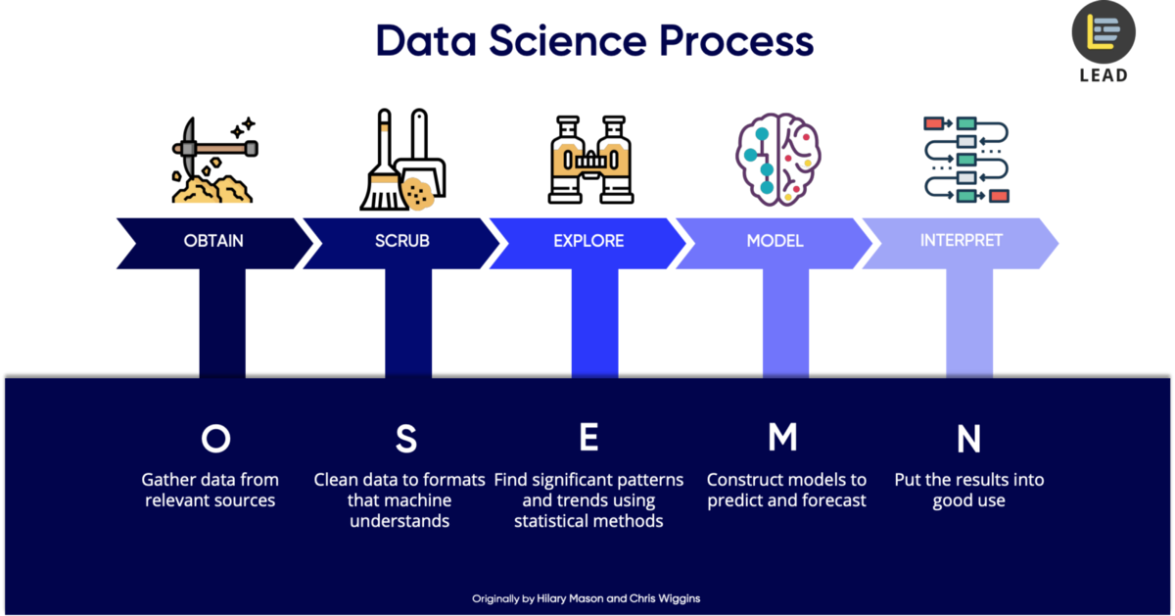
Introduction to the Science of Data
Joseph Marvin R. Imperial
DATA SCIENCE 1
NU College of Computing and Information Technologies
COURSE CODE: CCDATSC1L

Slide 3
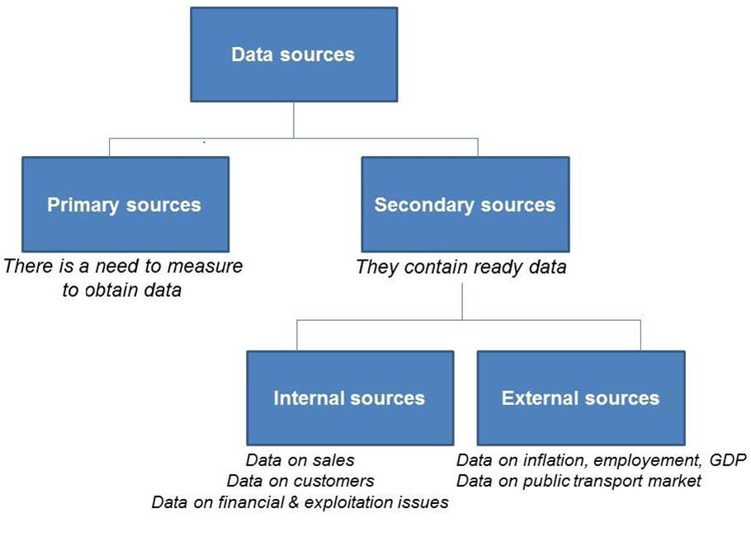
Data Collection
the process of gathering and measuring information on variables of interest, in an established systematic fashion that enables one to answer stated research questions, test hypotheses, and evaluate outcomes.
Possibly the most time consuming and expensive part of any data science / research task aside from cleaning.
Introduction to the Science of Data
Joseph Marvin R. Imperial
DATA SCIENCE 1
NU College of Computing and Information Technologies
COURSE CODE: CCDATSC1L

Slide 4
Risks in Data Collection
Giving away a lot of personal data gives a lot of power to the person / company collecting it. Case to case basis.
Unintentional collection of copyrighted data. Often happens in collecting data online.
Collecting data does not infinitely lead to more value. Instead, returns of scale on data will eventually decrease as the information will stop being relevant to what you are trying to achieve.
Collecting blindly without establishing a goal beforehand, will complicate the differentiation between valuable and dispensable data. Know what you want to collect.
The risks of collecting data indiscriminately are real. But done properly, the benefits are equally evident (Accenture).
Introduction to the Science of Data
Joseph Marvin R. Imperial
DATA SCIENCE 1
NU College of Computing and Information Technologies
COURSE CODE: CCDATSC1L

Slide 5
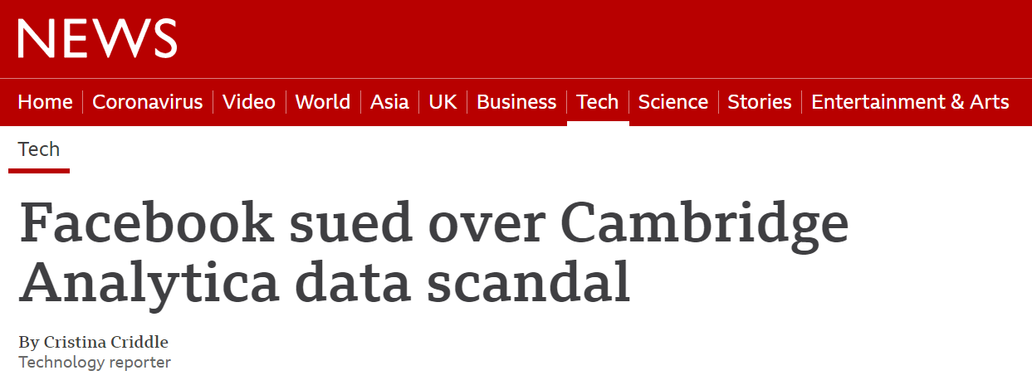
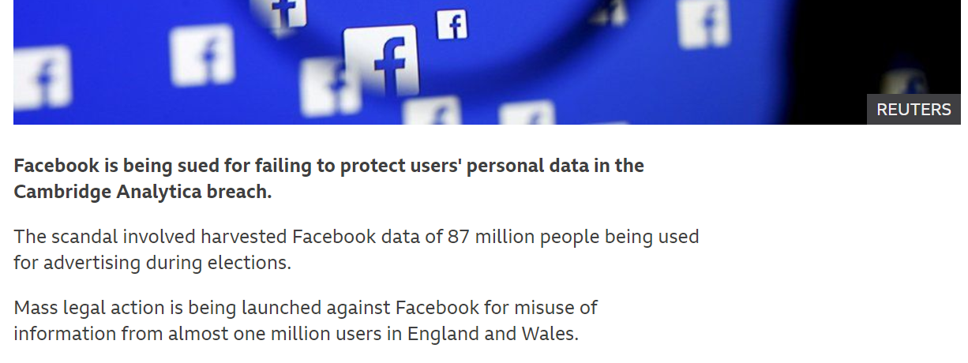
Facebook Cambridge-Analytica Scandal
Introduction to the Science of Data
Joseph Marvin R. Imperial
DATA SCIENCE 1
NU College of Computing and Information Technologies
COURSE CODE: CCDATSC1L

Slide 6
Facebook Cambridge-Analytica Scandal
The scandal involved harvested Facebook data of 87 million people being used for advertising during elections without consent.
The hole started with a University of Cambridge psychologist, who had requested and gained access to information from 270,000 Facebook members after they chose to download his personality prediction app, a Facebook-based quiz app. Reports saiddata breach reached 50 million.
Aftermath? Facebook now removed public collection of posts, comments, etc. This curtailed research opportunities for the platform.
Introduction to the Science of Data
Joseph Marvin R. Imperial
DATA SCIENCE 1
NU College of Computing and Information Technologies
COURSE CODE: CCDATSC1L

Slide 7
Best Practices in Data Collection
Your data sets need to be checked and cross referenced for data quality and integrity.
You have to know the rules and regulations of websites or applications where data will be collected.
You have to ensure people’s rights to consent, privacy, security and ownership around the information processes of collection, analysis, storage, presentation and reuse of data, while respecting the values of transparency and openness.
You need to safeguard your data. Data breaches have serious negative effects on your business, your image, and the safety of your respondents.
In some cases, you need to be transparent. People want to know how and why you are collecting their data. So, tell them. Allow users to opt in or out of data collection, and tell them exactly how the information will be used.
Introduction to the Science of Data
Joseph Marvin R. Imperial
DATA SCIENCE 1
NU College of Computing and Information Technologies
COURSE CODE: CCDATSC1L

Slide 8
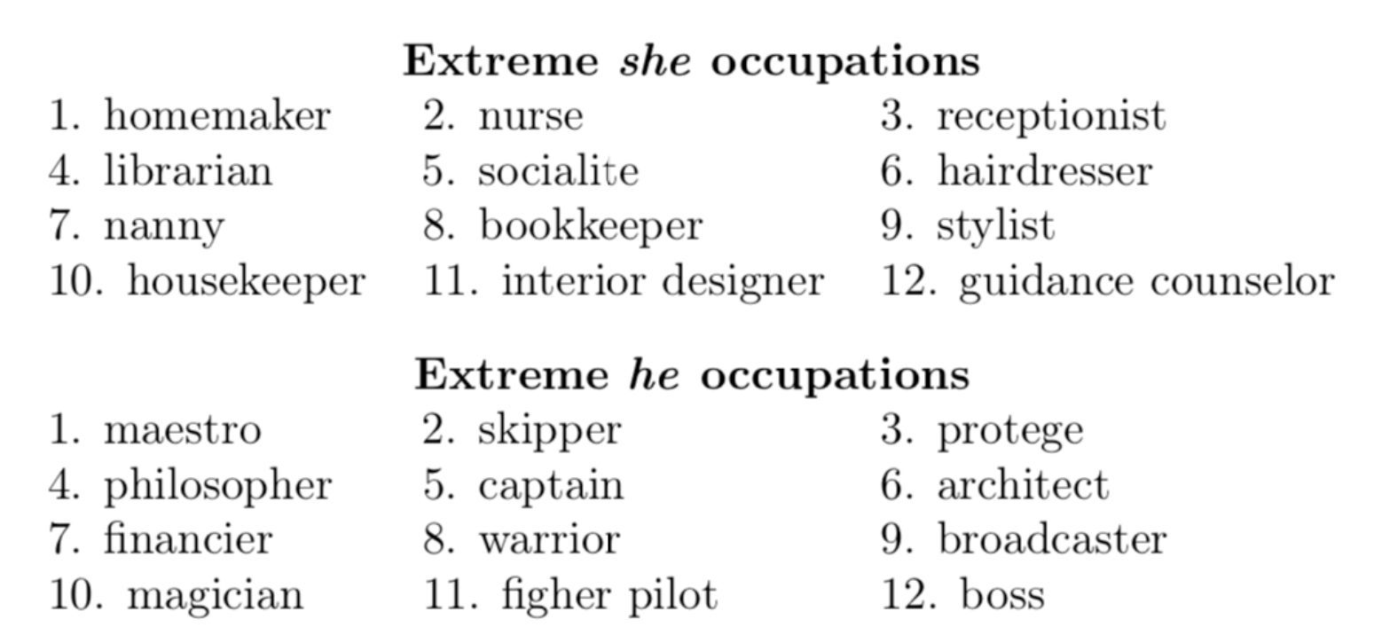
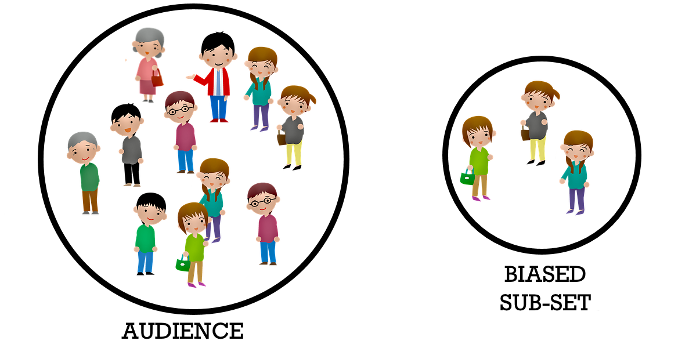
Bias in your data?
Bias starts with the data. Humans are already biased by nature.
Big datasets and models trained with these datasets are (100%) biased.
The most important aspect of a statistical analysis is not what you do with the data, it’s what data you use.
Introduction to the Science of Data
Joseph Marvin R. Imperial
DATA SCIENCE 1
NU College of Computing and Information Technologies
COURSE CODE: CCDATSC1L

Slide 9
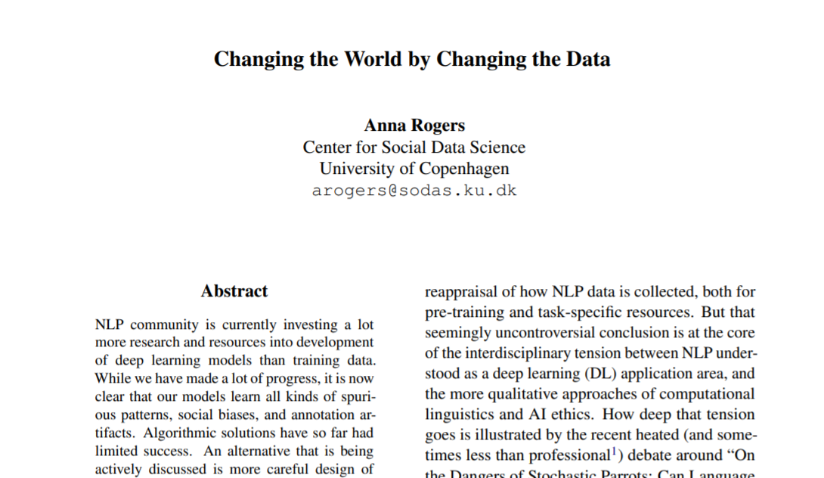
Bias in your data?
Introduction to the Science of Data
Joseph Marvin R. Imperial
DATA SCIENCE 1
NU College of Computing and Information Technologies
COURSE CODE: CCDATSC1L

Slide 10
Changing the World by Changing the Data (Rogers, 2021)
While we have made a lot of progress [in ML], it is now clear that our models learn all kinds of spurious patterns, social biases, and annotation artifacts. Algorithmic solutions have so far had limited success.
Models are representations of the data they were trained on.
Written texts contain plenty of evidence of all kinds of social biases based on gender, race, social status, ability, age, etc. Models may learn these biases and even amplify them, putting the minority groups at a disadvantage by direct psychological harm and propagation of stereotypes (Blodgett et al., 2020; Bender et al., 2021).
Garbage in, garbage out.
Introduction to the Science of Data
Joseph Marvin R. Imperial
DATA SCIENCE 1
NU College of Computing and Information Technologies
COURSE CODE: CCDATSC1L

Slide 11
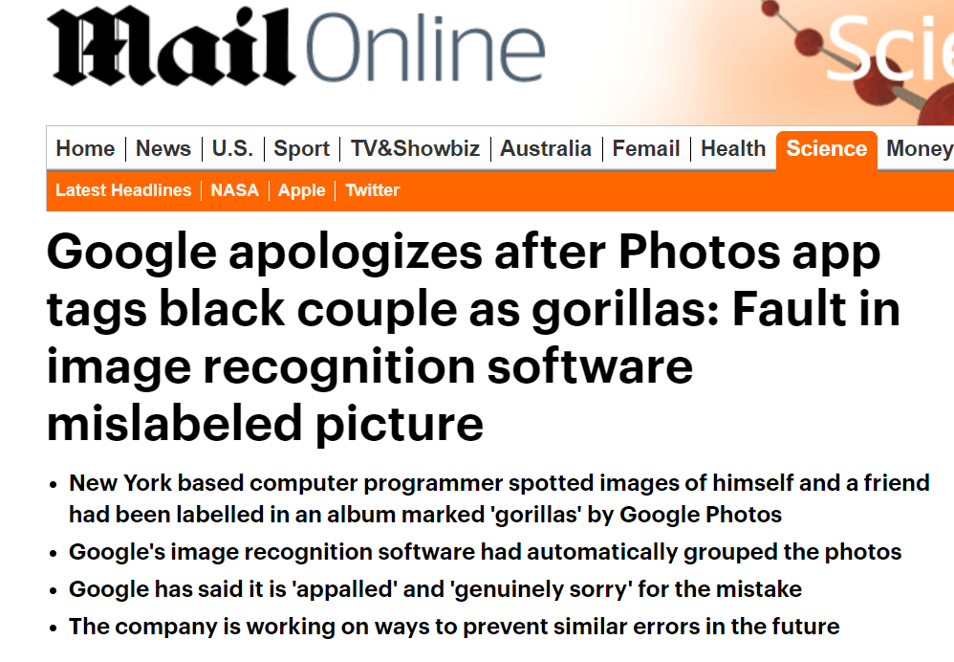
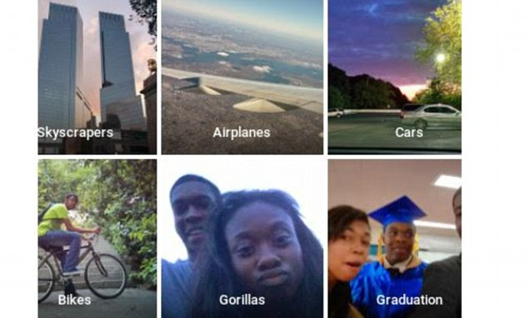
Introduction to the Science of Data
Joseph Marvin R. Imperial
DATA SCIENCE 1
NU College of Computing and Information Technologies
COURSE CODE: CCDATSC1L

Slide 12
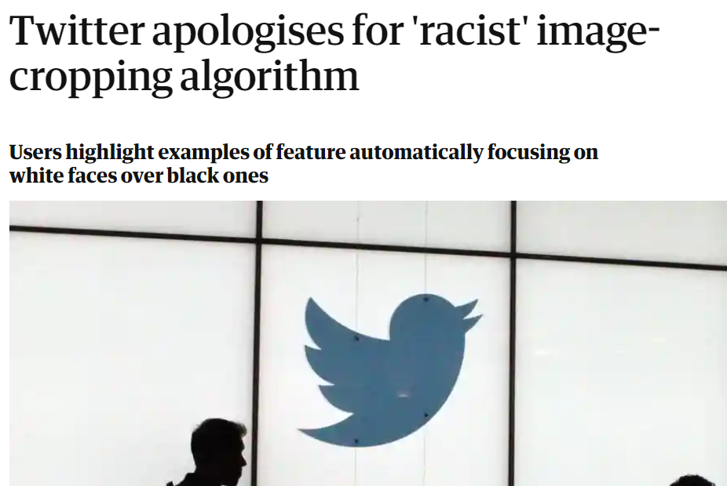
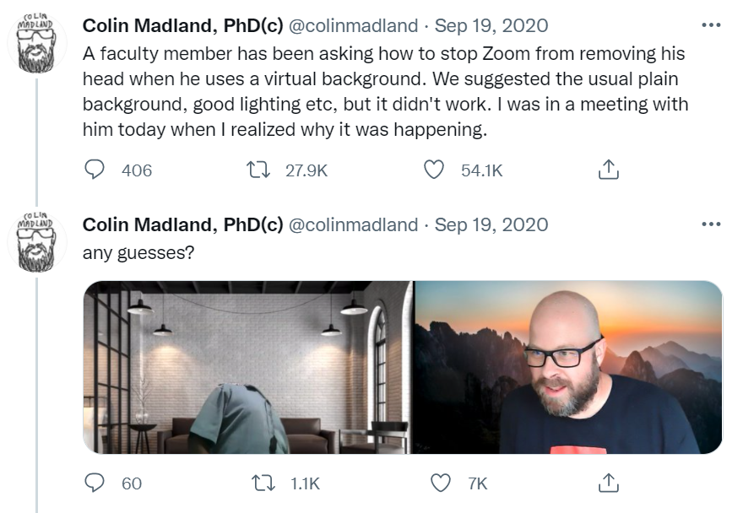
Introduction to the Science of Data
Joseph Marvin R. Imperial
DATA SCIENCE 1
NU College of Computing and Information Technologies
COURSE CODE: CCDATSC1L

Slide 13
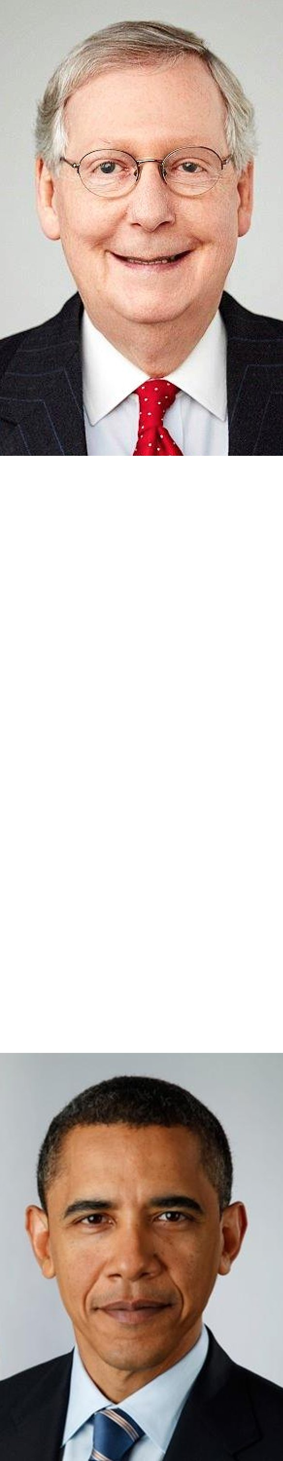
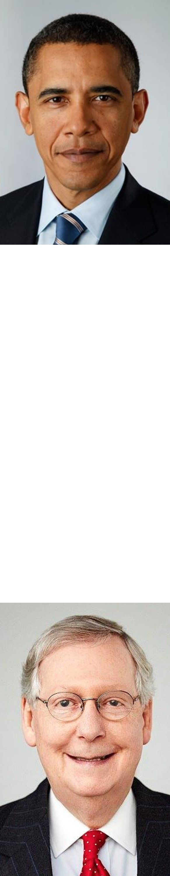
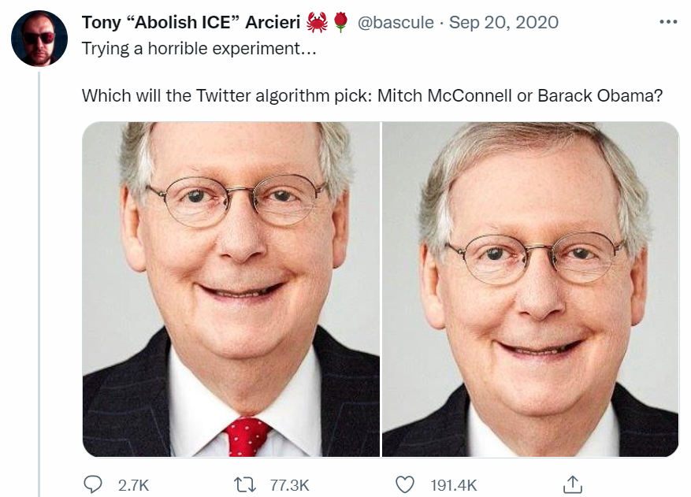
Introduction to the Science of Data
Joseph Marvin R. Imperial
DATA SCIENCE 1
NU College of Computing and Information Technologies
COURSE CODE: CCDATSC1L

Slide 14
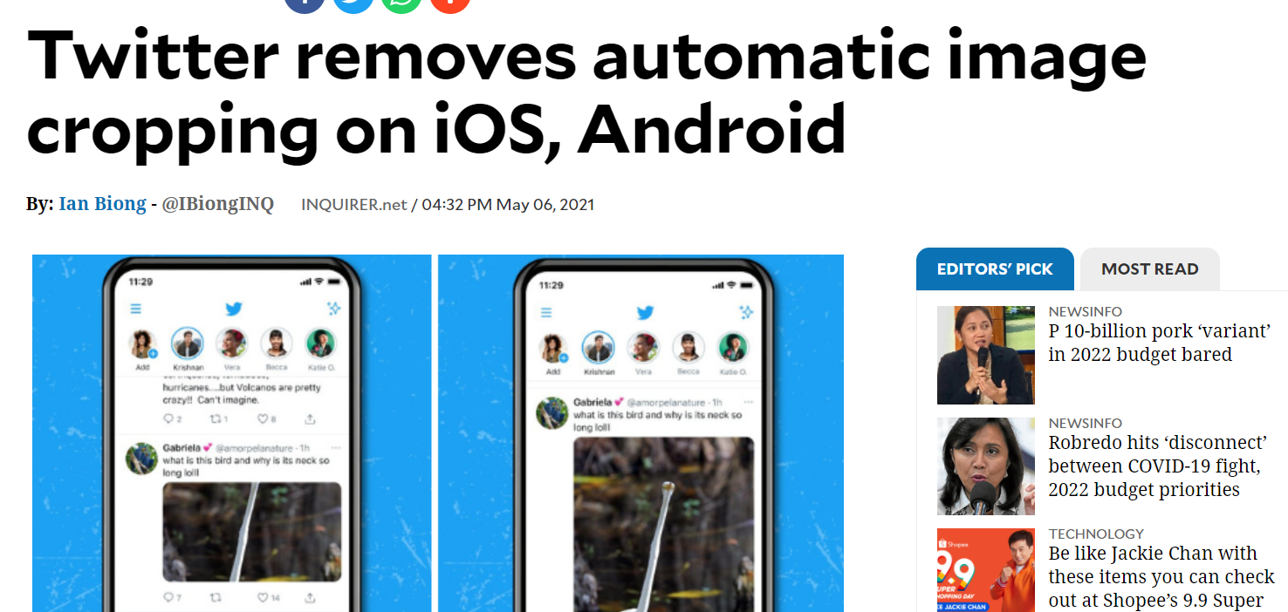
Result?
Introduction to the Science of Data
Joseph Marvin R. Imperial
DATA SCIENCE 1
NU College of Computing and Information Technologies
COURSE CODE: CCDATSC1L

Slide 15
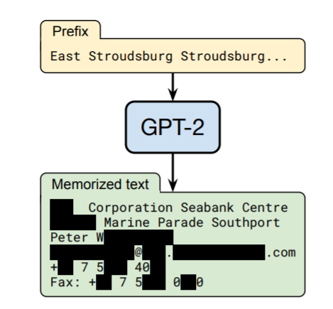
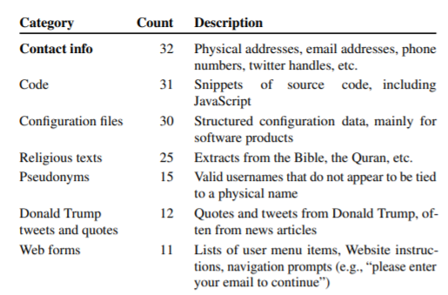
Privacy Concerns in Collection and Training
Models may memorize specific facts in training data, and if those facts happen to be personally identifiable information, this is a security concern (Rogers, 2021).
Large language models have knowledge of personal information such as cellular numbers and personal addresses linked to people (Carlini et al, 2020).
Introduction to the Science of Data
Joseph Marvin R. Imperial
DATA SCIENCE 1
NU College of Computing and Information Technologies
COURSE CODE: CCDATSC1L

Slide 16
Data Collection and Annotation Tools
Introduction to the Science of Data
Joseph Marvin R. Imperial
DATA SCIENCE 1
NU College of Computing and Information Technologies
COURSE CODE: CCDATSC1L

Slide 17
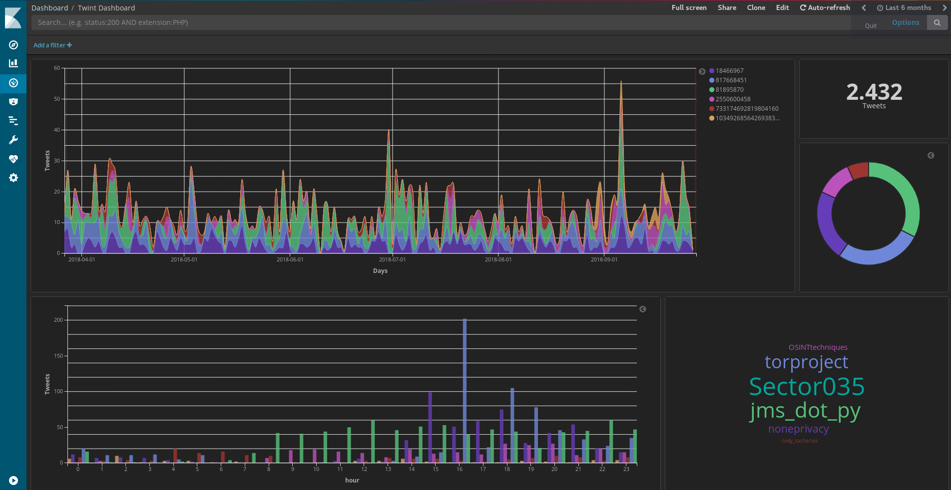
Twint (Twitter Intelligence Tool)
Twint is an advanced Twitter scraping tool written in Python that allows for scraping Tweets from Twitter profiles without using Twitter's API.
https://github.com/twintproject/twint
Introduction to the Science of Data
Joseph Marvin R. Imperial
DATA SCIENCE 1
NU College of Computing and Information Technologies
COURSE CODE: CCDATSC1L

Slide 18
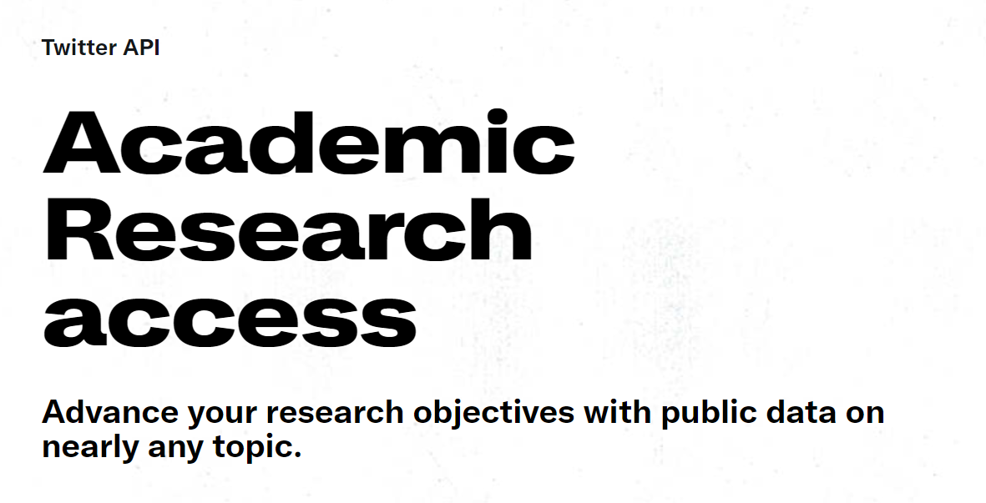
Twitter Academic API
https://developer.twitter.com/en/products/twitter-api/academic-research
Introduction to the Science of Data
Joseph Marvin R. Imperial
DATA SCIENCE 1
NU College of Computing and Information Technologies
COURSE CODE: CCDATSC1L

Slide 19

Amazon Mechanical Turk
Costs money. Amazon Mechanical Turk (MTurk) is a crowdsourcing marketplace that makes it easier for individuals and businesses to outsource their processes and jobs to a distributed workforce who can perform these tasks virtually.
https://www.mturk.com/
Introduction to the Science of Data
Joseph Marvin R. Imperial
DATA SCIENCE 1
NU College of Computing and Information Technologies
COURSE CODE: CCDATSC1L

Slide 20
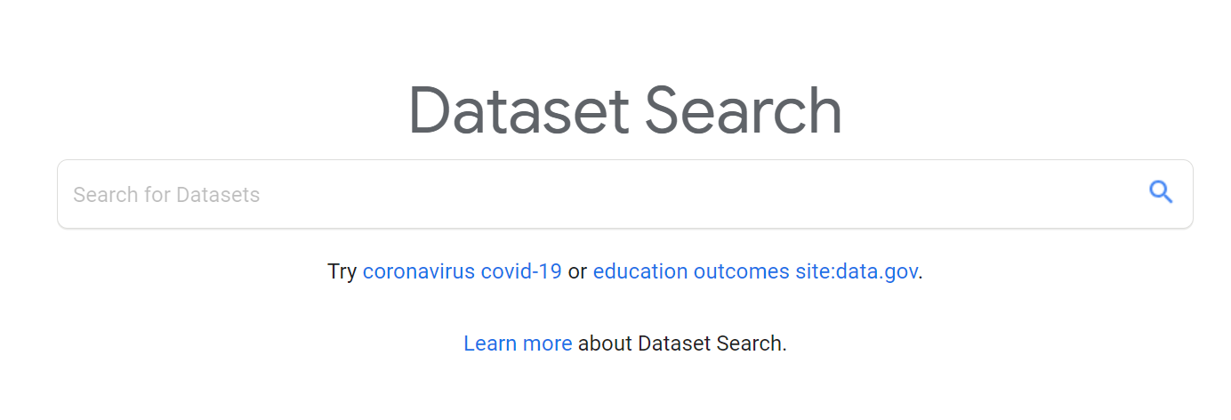
Google Dataset Search
https://datasetsearch.research.google.com/
Introduction to the Science of Data
Joseph Marvin R. Imperial
DATA SCIENCE 1
NU College of Computing and Information Technologies
COURSE CODE: CCDATSC1L

Slide 21

Papers With Code - Datasets
The mission of Papers with Code is to create a free and open resource with Machine Learning papers, code, datasets, methods and evaluation tables.
https://paperswithcode.com/datasets
Introduction to the Science of Data
Joseph Marvin R. Imperial
DATA SCIENCE 1
NU College of Computing and Information Technologies
COURSE CODE: CCDATSC1L

Slide 22
PLOC and NLP Research Primer
Philippine Languages Online Corpora
https://github.com/imperialite/Philippine-Languages-Online-Corpora
A Filipino Student's Guide to NLP Research
https://github.com/imperialite/nlp-research-primer-ph
Introduction to the Science of Data
Joseph Marvin R. Imperial
DATA SCIENCE 1
NU College of Computing and Information Technologies
COURSE CODE: CCDATSC1L

Slide 23
References
University of Helsinki. Introduction to Data Science course.
Johns Hopkins University. Advanced Data Science course.
Introduction to the Science of Data
Joseph Marvin R. Imperial
DATA SCIENCE 1
NU College of Computing and Information Technologies
COURSE CODE: CCDATSC1L

